Slide 1
Data Exploration Insights
Deepika Dash
10 March 2016

Slide 2
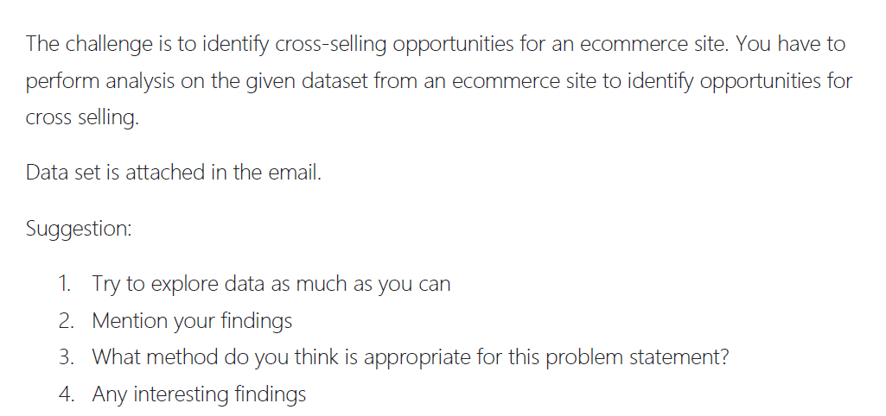
Problem Statement

Slide 3
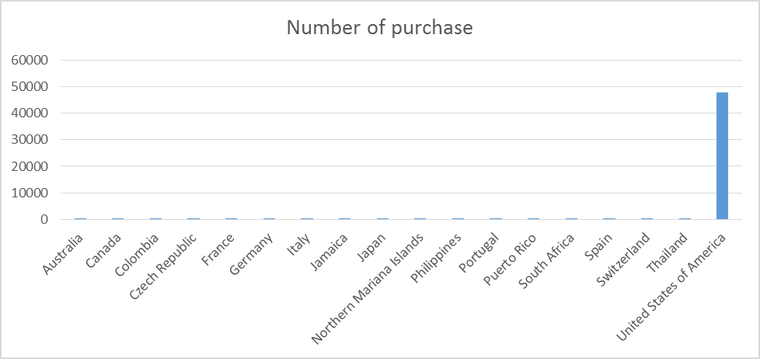
Observation 1
Country with maximum purchase:
USA contributes to almost(99%) all sale.
Country | Number of purchase
Australia | 21
Canada | 13
Colombia | 1
Czech Republic | 12
France | 4
Germany | 28
Italy | 1
Jamaica | 2
Japan | 1
Northern Mariana Islands | 2
Philippines | 16
Portugal | 14
Puerto Rico | 164
South Africa | 5
Spain | 1
Switzerland | 6
Thailand | 16
United States of America | 48016

Slide 4
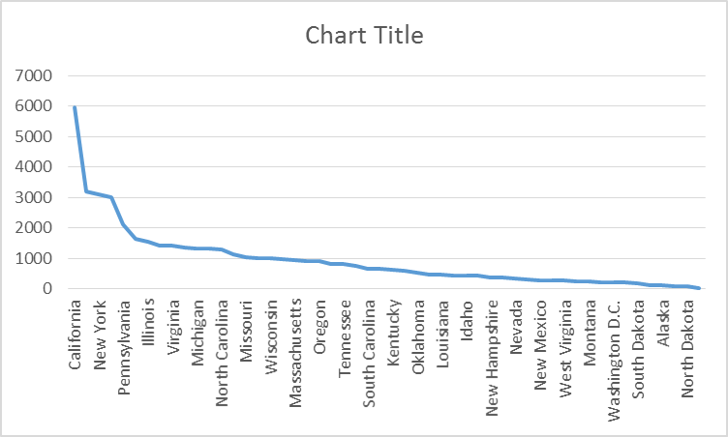
Observation 2
US region wise purchase:
36.23% of purchase are made by top 5 regions out of 53 regions.
Region | Number of purchase
California | 5951
Florida | 3210
New York | 3095
Texas | 3019
Pennsylvania | 2120
Ohio | 1631
Illinois | 1551
Utah | 1430
Virginia | 1412
Washington | 1339
Michigan | 1327
Georgia | 1306
North Carolina | 1304
Minnesota | 1139
Missouri | 1029

Slide 5
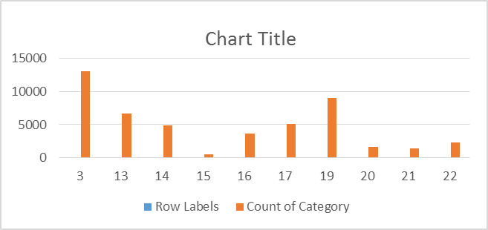
Observation 3
Day with maximum purchase
Beginning of the month contribute to maximum sale. Though we don’t have much data to proof the hypothesis but with available data it looks so. More granular we can look for which day of the week contribute to more sale
Date | Number of Purchase
3 | 13076
13 | 6690
14 | 4848
15 | 576
16 | 3605
17 | 5086
19 | 9027
20 | 1664
21 | 1380
22 | 2372

Slide 6
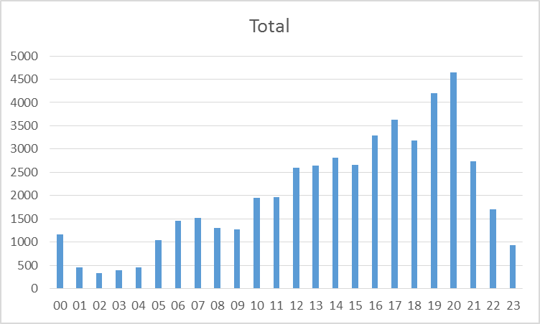
Observation 4
Hour | Total
00 | 1166
01 | 460
02 | 336
03 | 388
04 | 457
05 | 1039
06 | 1461
07 | 1521
08 | 1301
09 | 1277
10 | 1947
11 | 1960
12 | 2590
13 | 2636
14 | 2807
15 | 2652
16 | 3295
17 | 3625
18 | 3179
19 | 4199
20 | 4654
21 | 2739
22 | 1700
23 | 934
Purchase day time
There is continuous increment in purchase is observed from morning 10.00 a.m. to
night 8 p.m. with night 8 p.m. contributing the maximum purchase

Slide 7
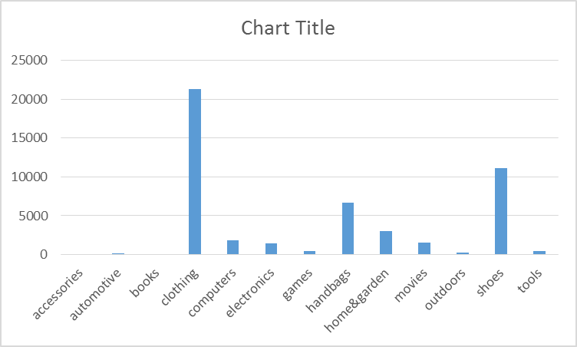
Observation 5
Most and least things that is purchased
Clothing is most thing that is been sold & accessories and books to be minimum
Category | Number of Purchase
accessories | 11
automotive | 114
books | 22
clothing | 21336
computers | 1869
electronics | 1453
games | 496
handbags | 6673
home&garden | 2982
movies | 1527
outdoors | 247
shoes | 11147
tools | 447

Slide 8
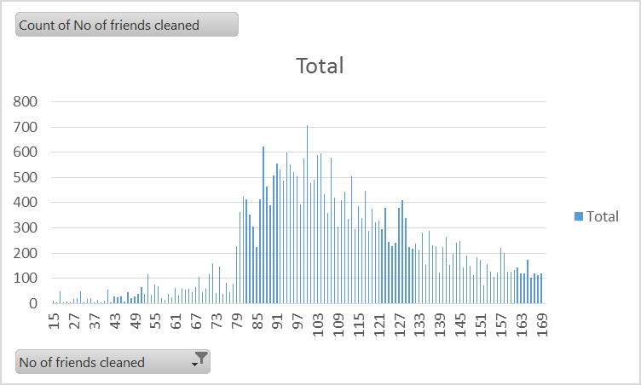
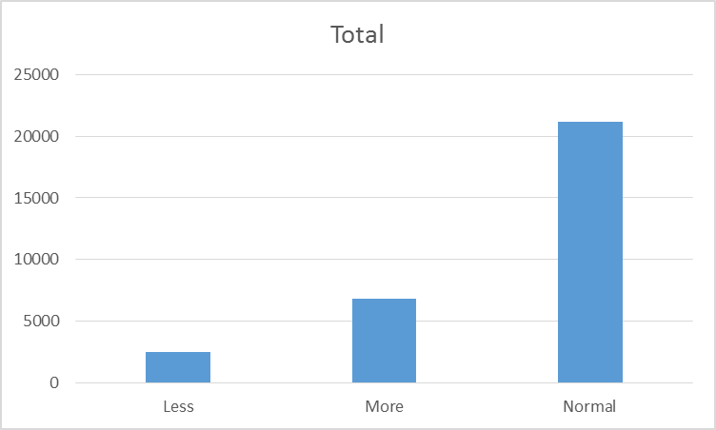
Observation 6
Number of friends distribution:
1. Basically whole distribution can be divided in to 3 groups.
Group with number of friends < 80 (less),
<130 & >80 (Normal), >130(More)
User conversion with friends distribution:
2. People with less & more number of friend are not very converging

Slide 9
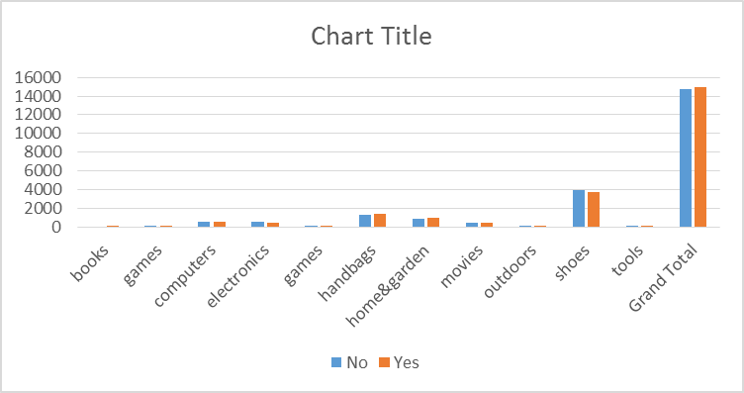
Observation 7
Comparison between college going user purchase and non college going user:
There is no difference between purchase of both category (College going and not going)
College Going | books | games | computers | electronics | games | handbags | home&garden | movies | outdoors | shoes | tools | Grand Total
No |  | 103 | 572 | 537 | 103 | 1283 | 870 | 389 | 11 | 3909 | 6 | 14729
Yes | 1 | 94 | 561 | 409 | 94 | 1406 | 967 | 421 | 18 | 3732 | 22 | 14937

